Slide 1
SMART BULB
HARSHITH:-1602-16-737-015
IRSHAD:-1602-16-737-017

Slide 2
MOTIVATION
Smart Bulbs aren’t your average LED . They don’t just sit in a socket and light a room like your basic bulb. That’s boring . Smart bulbs can do such more.
Smart Bulbs are called smart for a reason , they can wirelessly connect with phone apps , a capability that opens up major possibilities.
Some Smart bulbs , such as Belkin,WeMo LED etc., can be controlled when you aren’t home.

Slide 3
Use cases:
This is a great security option when you are on vacation, because your home never looks empty.
It also means you can come home to a lit house without leaving your lights on and wasting electricity.
Most light brands offer a hub that can sync all of your lights together so you can control all of them with one app.

Slide 4
Smart bulbs also saves our time and energy.
There is no need to be same Network connection for both bulb and the mobile from which we are operating that respective bulb.
LED lighting doesn’t just use less energy than traditional incandescent lighting, it also lasts up to 25 times longer. What’s more, almost all smart lights use LED bulbs.

Slide 5
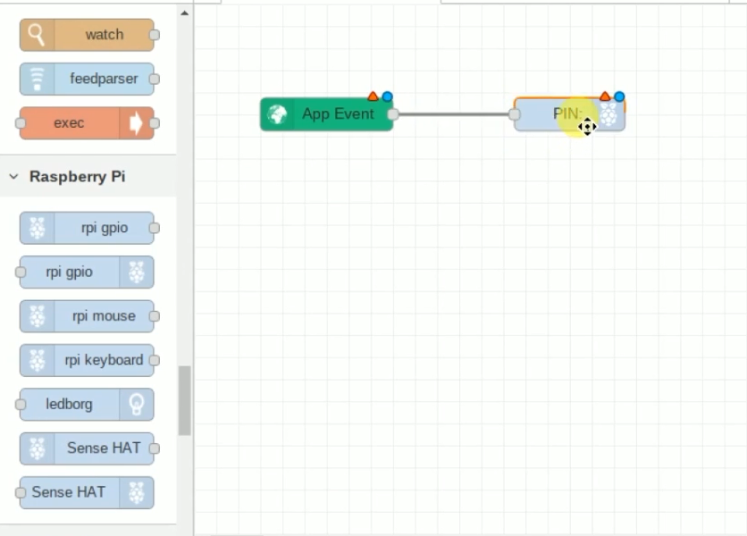

Slide 6
Technology used:
NodeRED
Node-RED is a programming tool for wiring together hardware devices,APIs and online services in new and interesting ways.
BlynkApp:
It is a platform with iOS and Android apps to control Arduino,Raspberry pi etc,.

Slide 7
Requirements:
Rpi or Arduino or NodeMCU
Bulb
Mobile

Slide 8
Thank You!!

